Slide 1
EudraCT Project
Simon Bond 30th April 2019

Slide 2
Elevator Pitch
All CTIMP studies are required to enter results into EudraCT within 1 year of completion
Detailed safety results could take 1000s of hours to enter by hand
Or upload an XML with the data in seconds.

Slide 3
Overview
Update on Safety data project
Worked Example
Where to find resources
Opportunities to contribute
Discussion on Future extensions
Notes:
3

Slide 4
Project Timelines: End date is October 19
Survey
Specification Document
Website
Github code sharing and collaboration
Draft versions of code
Testing
Documentation

Slide 5
Doing one thing well (to start with)
Produce summary safety stats
Advisory code not tested, or use your own
Versions for R, Stata, SAS
Data provided to link to EudraCT codes for SOCs
Standardise column names and save in “simple” XML
R package function - tested
SAS Proc Datasets (but limited by variable name length)
Stata code
XSLT script to convert from “Simple” to EudraCT xml.

Slide 6
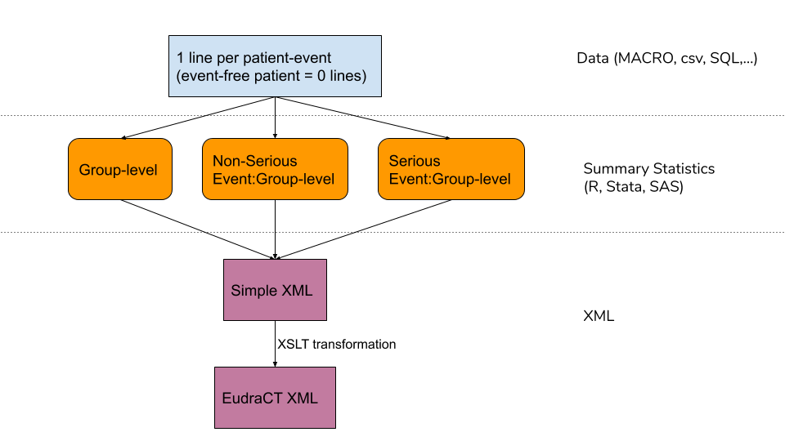
Flow Chart of process

Slide 7
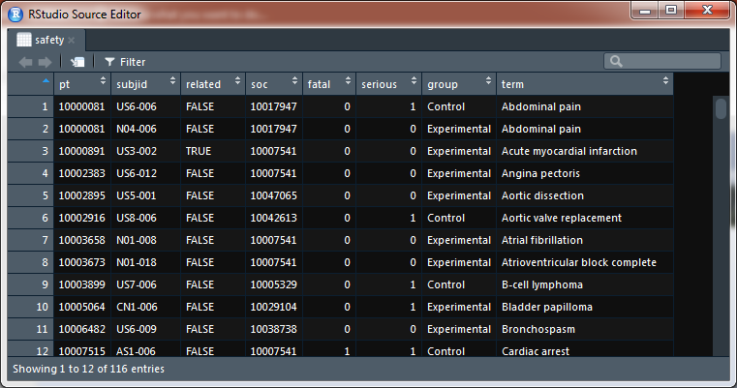
Input Data

Slide 8
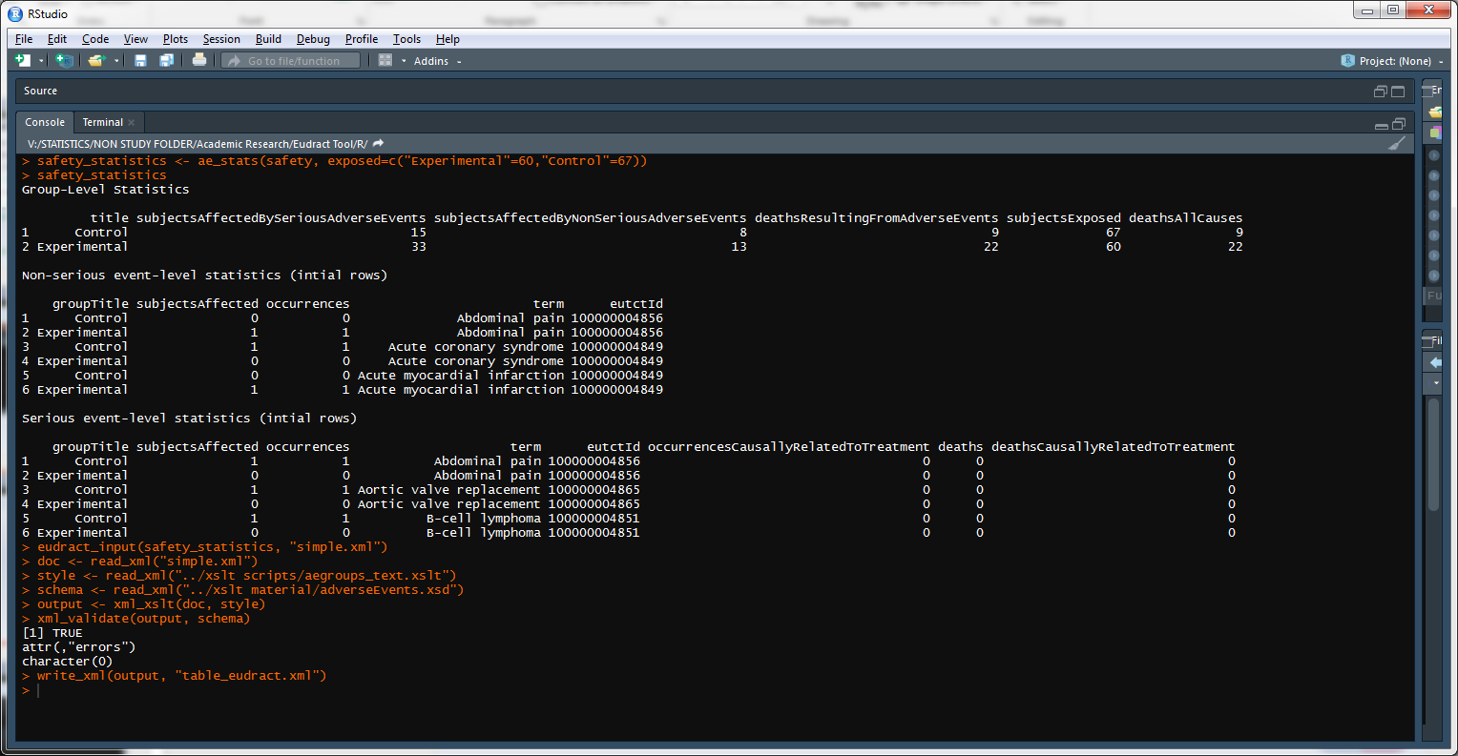
R Code

Slide 9
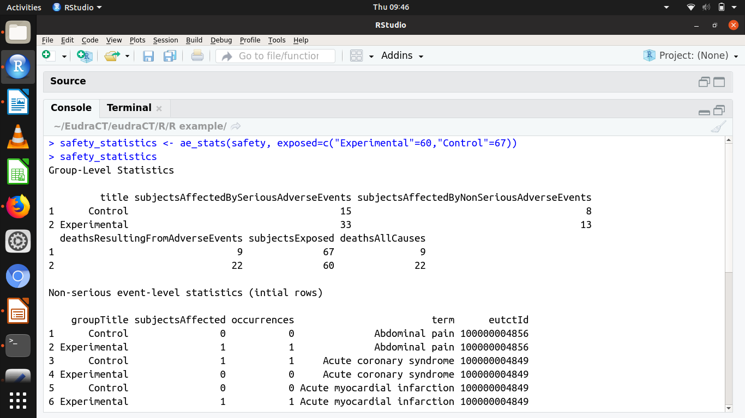

Slide 10
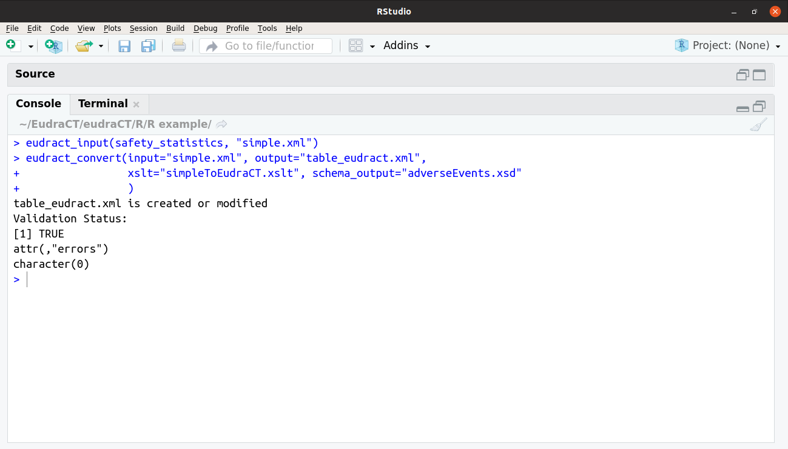

Slide 11
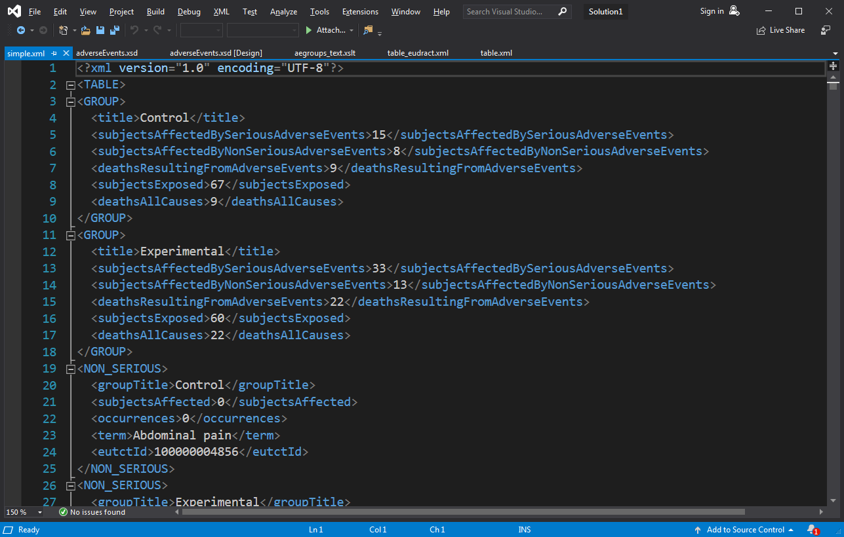
Save in Simple xml with standard names

Slide 12
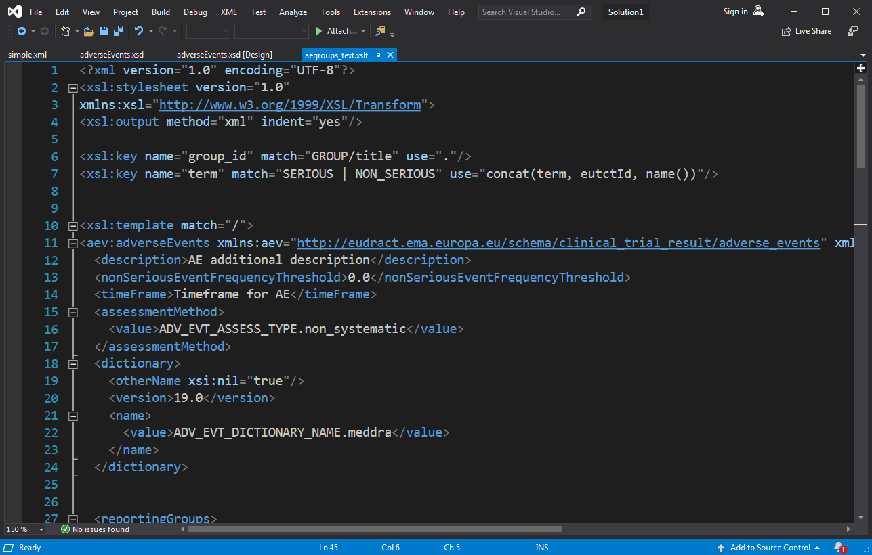
Transformation code: 108 lines

Slide 13
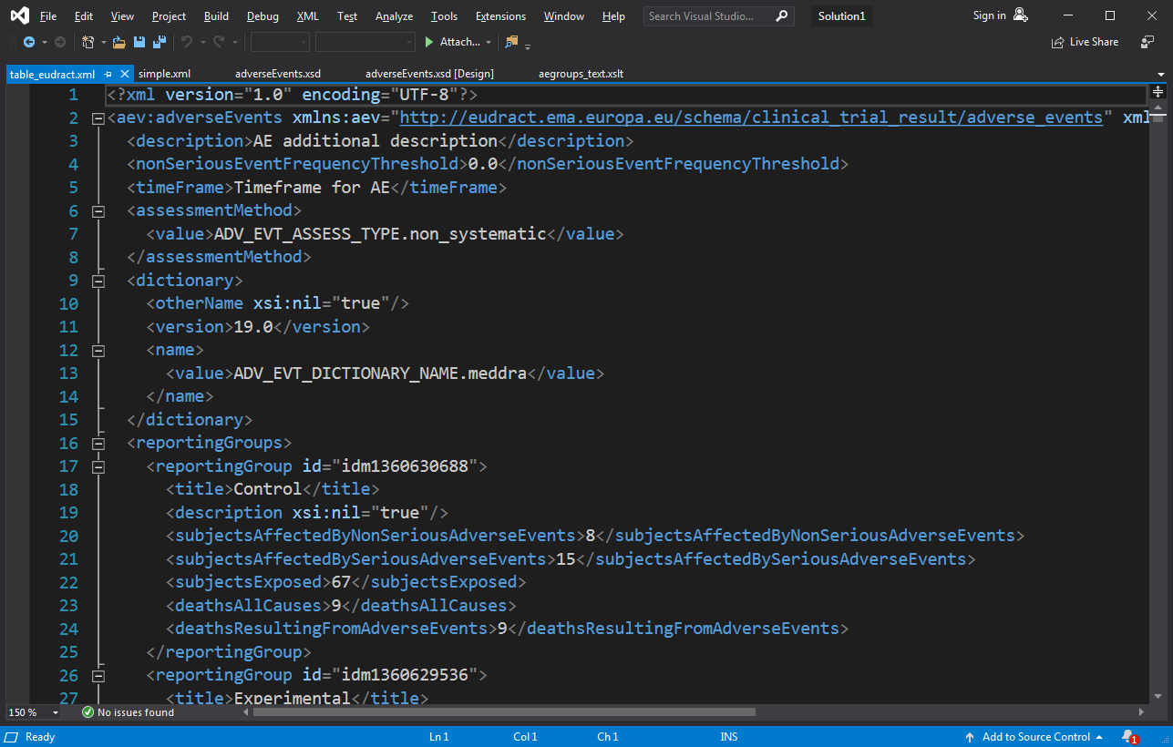
Final Output

Slide 14
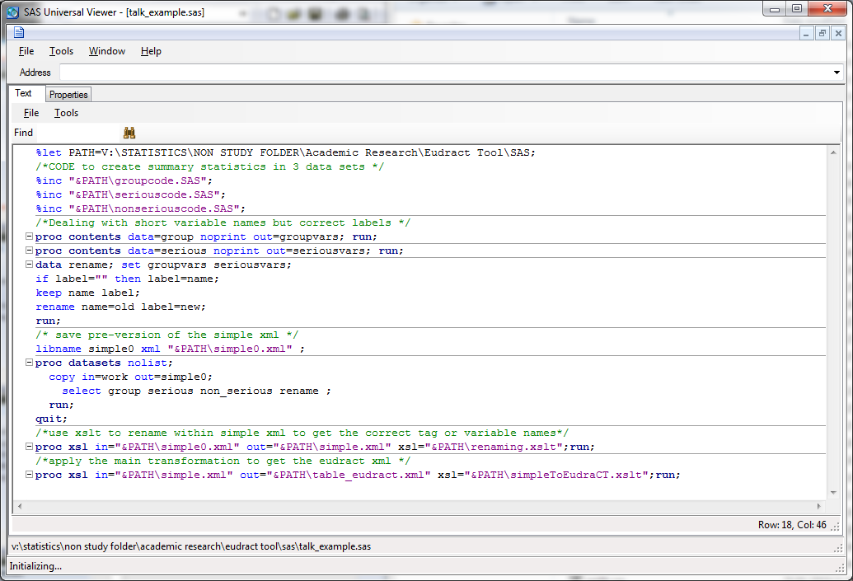
SAS Equivalent

Slide 15
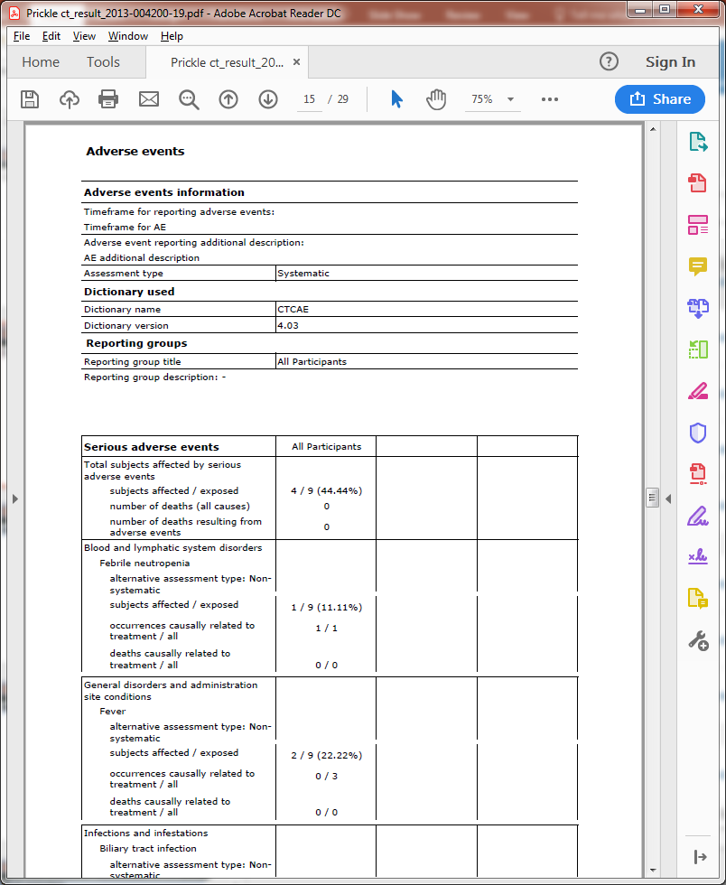
Final Report from EudraCT

Slide 16
Unification across R/SAS/Stata
Could export directly writing output mixing text and data
Print (“<blah>”, count[i,j], “</blah>”)
But: one unified XSLT stage for the details
Easy to amend for future changes
Open-source code on GitHub for anyone to propose amendments
Leaves the statisticians to do statistics
Need to export into “Simple” XML from Stata

Slide 17
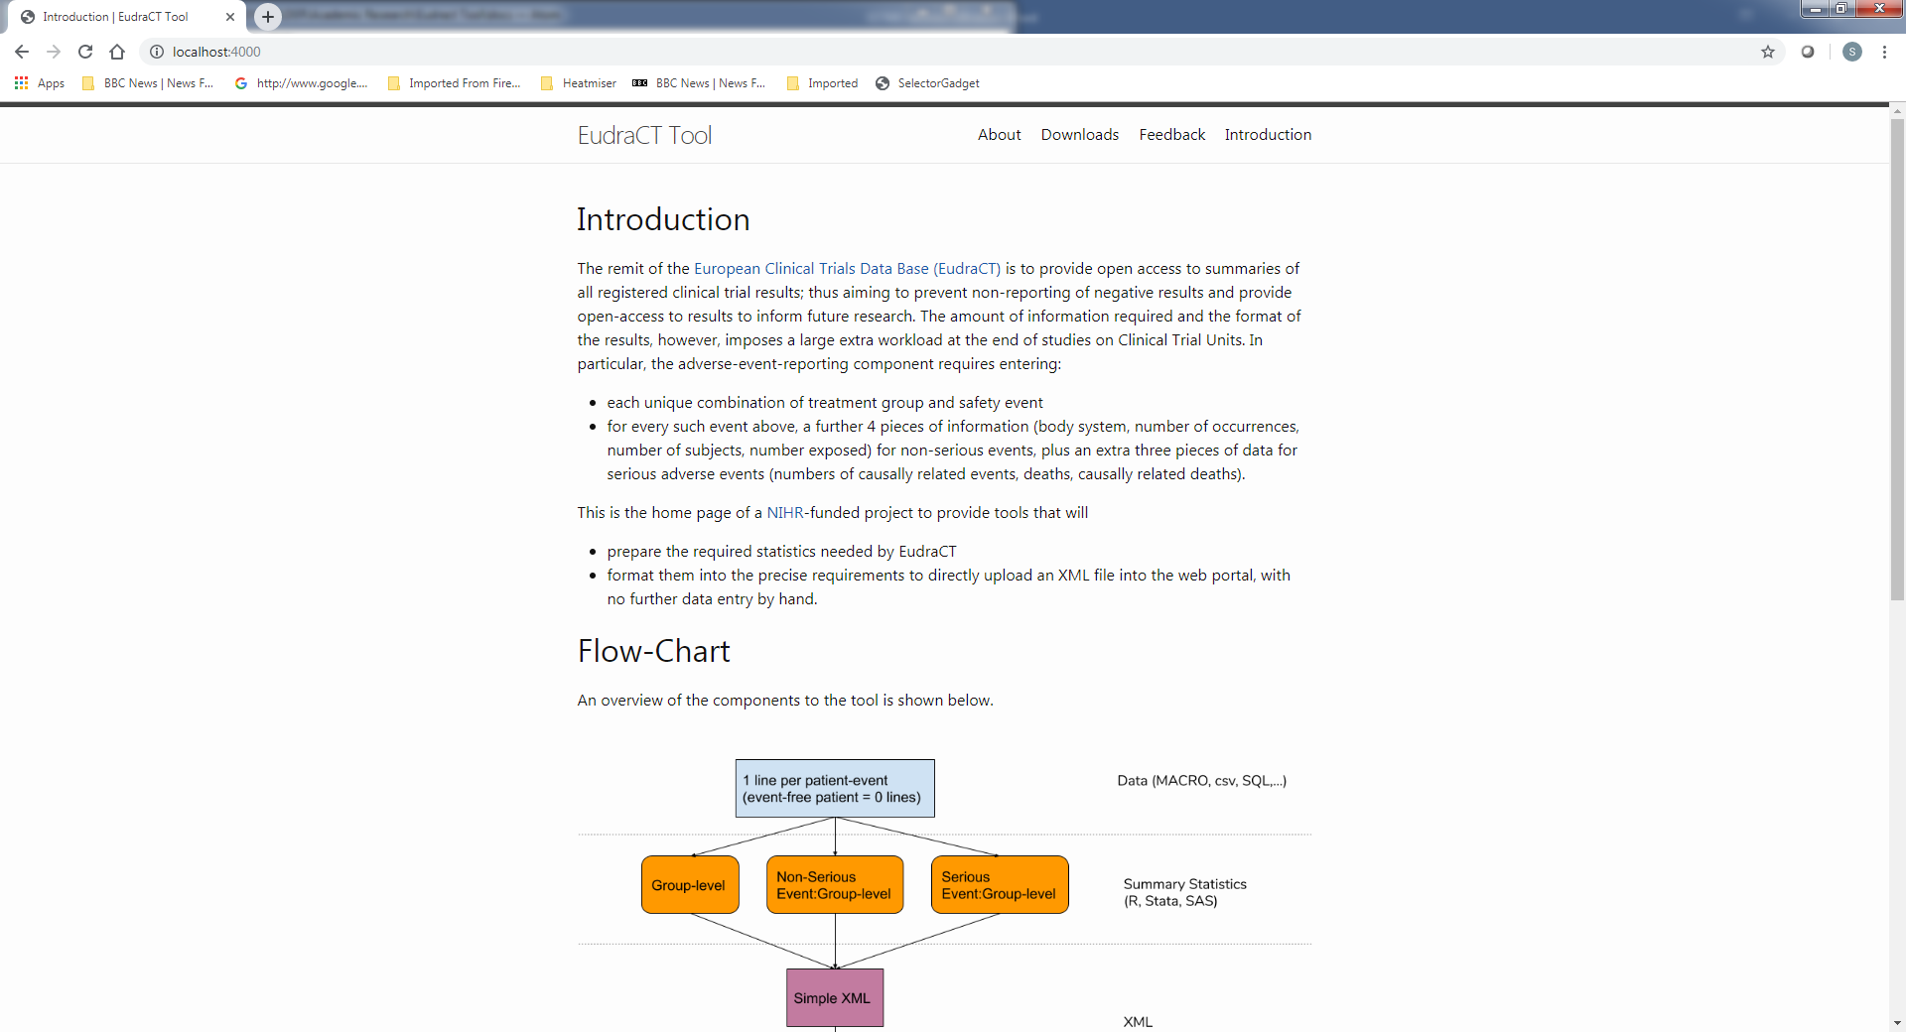
https://eudract-tool.medschl.cam.ac.uk

Slide 18
Where can you get this
R Code -> package via the github link
SAS code equivalent..
Stata code equivalent?
Documentation
Training

Slide 19
Test overview
Use the training version of EudraCT
Take a past trial already uploaded to EudraCT from another CTU, and compare output
Unit testing within R, Stata,SAS.
Feedback from other units welcome

Slide 20
Acknowledgements
Birmingham
Leeds
Glasgow
All who participated in the Survey and spec feedback
NIHR funding

Slide 21
Future Direction: Discussion
Extensions:
Baseline
Efficacy
Meta Data
Beyond EudraCT
ClinicalTrials.gov
CDISC

Slide 22
Extra Slides

Slide 23
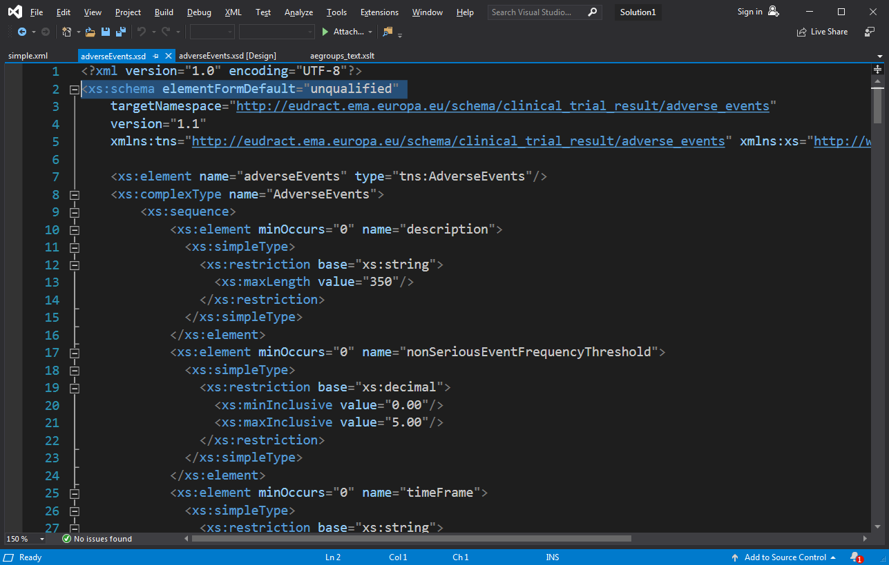
Schema downloaded from EudraCT

